Slide 1

PREDICHECK
~
Code Found

Slide 2
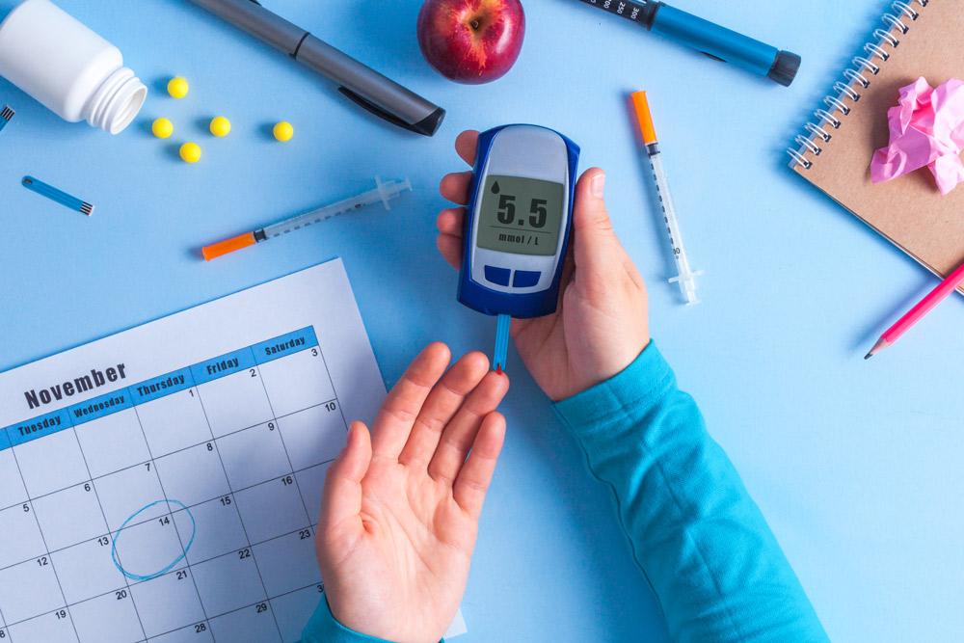
Problem Statement
According to the International Diabetes
Federation, over 600 million adults are
projected to have diabetes by 2035 globally.
Early detection is critical—80% of diabetes
cases remain undiagnosed,especially in
low-resource settings.
Lack of affordable, accessible screening
tools hinders timely intervention
and prevention.
Solution Overview
Developed an AI-powered web application for personalized
prediabetes and diabetes risk prediction using clinical
and symptomatic data.
Employs a TensorFlow.js model trained on 16 health indicators
correlated with diabetes risk.
Provides risk probability, key contributing factors, and actionable recommendations instantly.
Includes secure user accounts and longitudinal tracking of
assessments via Supabase.

Slide 3

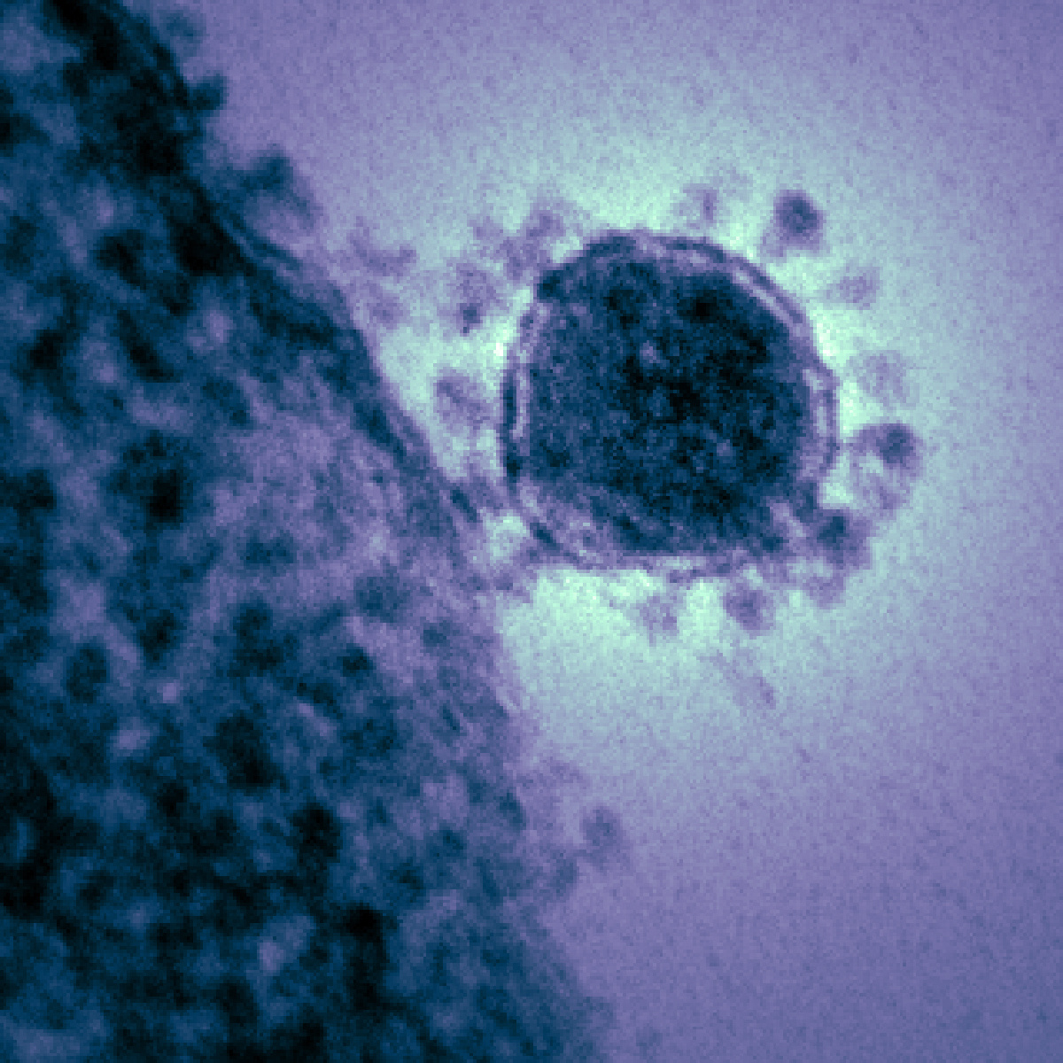
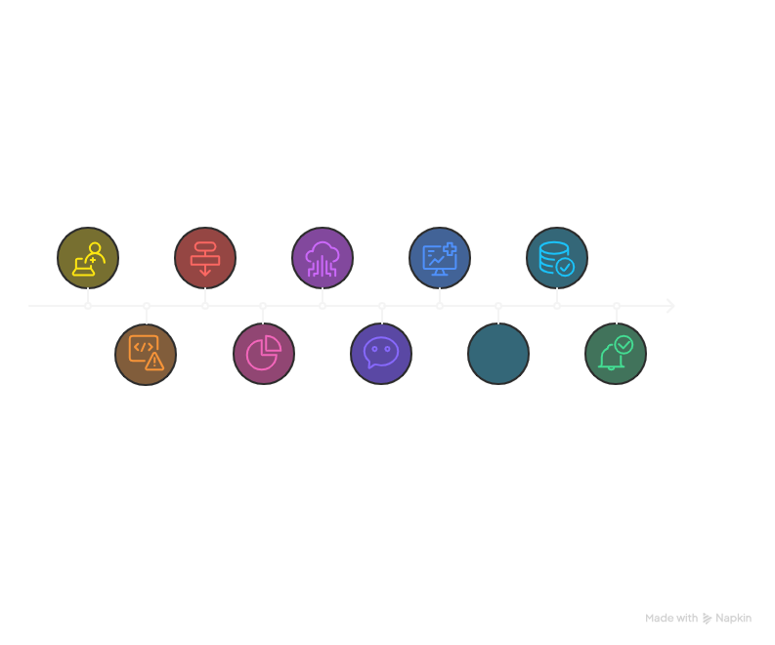

How it works
User fills out and submits health assessment form
Form data converted and proceed by TensorFlow.js model
Prediction result sent to external webhook via HTTP POST
Prediction results, symptoms, and recommendations displayed
assessment data and results saved in database if user authenticated
Numeric result converted to resk percentage and category
Success/error notifications and smooth scrolling for user experience
App validates required fields; show error if incomplete
app captures and display webhook response text
user can connect to professionals in the field

Slide 4
4. Architecture
Frontend: React for responsive and accessible health assessment forms.
Backend: Supabase providing user authentication and secure data storage.
AI Model: Client-side TensorFlow.js model allows instant, privacy-preserving prediction without server overhead.
Extended Integration: Make.com workflow integrated with Google Gemini for generating comprehensive, evidence-based medical advice.

Slide 5
5. Demonstration
User provides demographic (age, gender) and symptom details via form.
AI model outputs a risk score as a percentage and categorizes risk into three levels:
Low (<30%)
Moderate (30-70%)
High (>70%)
Displays key contributing symptoms such as polyuria, polydipsia, weight loss, and obesity.
Issues tailored recommendations validated against clinical guidelines.

Slide 6
6. Innovation and Differentiators
Efficient client-side inference reduces latency and enhances user privacy.
Cloud backend supports multi-user management and historical data tracking.
AI-generated personalized recommendations augment clinical value.
Modular design allows expansion to other chronic disease risk assessments.

Slide 7
7. Impact and Outcomes
Enables early intervention, reducing risk of serious complications such as cardiovascular disease and kidney failure.
Provides a cost-effective screening alternative with potential reach to millions lacking access to clinical diagnostics.
Empowers users with data-driven insights promoting lifestyle modifications and medical consultation.
Supports public health goals of reducing diabetes burden.

Slide 8
8. Future Enhancements
Continuous model retraining on larger datasets for improved accuracy.
Multilingual support and accessibility features to broaden reach.
Integration with wearable devices and electronic health records for comprehensive monitoring.
Incorporation of telemedicine consultations and follow-up reminders.

Slide 9
Conclusion
Our AI-driven application demonstrates scalable, user-friendly diabetes risk assessment grounded in clinical evidence.
Combines innovative frontend, AI models, and backend technologies to empower preventive healthcare.
Aligns with national and global health objectives toward early detection and management of diabetes.

